Slide 1
Data Representations
In this, we examine the several formats a computer uses to store information it is to operate on.
But because computers are binary in nature, all formats must be patterns of 1’s and 0’s.

Slide 2
Decimal System
In everyday life we use a system based on decimal digits (0, 1, 2, 3, 4, 5, 6, 7, 8, 9) to • represent numbers.
This system is referred to as the decimal system.
In the decimal system, 10 different digits are used to represent numbers with a base of 10.

Slide 3
Binary System
In the binary system, we have only two digits, 1 and 0.
Thus, numbers in the binary system are represented to the base 2.
A computer uses binary digits (0’s and 1’s) to store data in different formats.
These binary digits are called BITS.
In Computer circuits, 0’s and 1’s are voltage levels:
0 is low voltage (OFF)
1 is high Voltage (ON)

Slide 4
Data Formats
Numeric formats
They store only numbers; There are three numeric formats:
➢Integer or Fixed point Formats.
➢ Floating Point Formats
➢ Binary Coded decimal (BCD)
2. Alphanumeric Codes
Store both numbers and characters including the alphabetic characters.

Slide 5
NUMERIC FORMATS
Integer formats
Binary
To convert from decimal to binary we do successive divisions
Examples
244(11110100), 145(10010001), 112(1110000), 25673, 100, 57
Trial
1. Convert the following decimal numbers to base two.
2. Convert them to hexadecimal after.
12999, 555, 294, 160, 891, 76.

Slide 6
To convert from binary to decimal we expand e.g.
11011 = (1 * 2⁴) + (1 * 2³) + (0 * 2²) + (1 * 2¹)+ (1 * 2⁰)
= 16 + 8 + 0 + 2 + 1
= 27₁₀.
Others :
111001(57), 100011(35), 11001011(203), 10101101(173), 1011(11)
Trial
Convert the following binary numbers to decimal base
Convert them to hexadecimal.
10101, 1101, 1001, 1101001, 10111, 111, 101010

Slide 7
HEXADECIMAL
In hexadecimal notation, binary digits are grouped into sets of four.
Each possible combination of four binary digits is given a symbol.
It has 15 digits 0 – 15

Slide 8
HEXADECIMAL
Each Hexadecimal digit can be represented by a unique combination of 4 binary bits; e.g.
> 110011011 = 0001 1001 1011
1 9 B₁₆
To convert 1C2E₁₆ to decimal you expand using powers of 16.
= (1 * 16³) + (12 * 16²) + (2 * 16¹) + (14 * 16⁰)
= 4096 + 3072 + 32 + 14
= 7214₁₀
_{NOTE}
To convert 15797₁₀ to hexadecimal we perform successive divisions by 16.

Slide 9
OCTAL
Each octal digit can be represented by a unique combination of three bits. e.g.
110011011₂ = 110 011 011₂ = 633₈
101011000110₂ = 101 011 000 110 = 5306₈ = 1010 1100 0110 = AC6₁₆
1573₈ = 001 101 111 011₂ = 0011 0111 1011 = 37B₁₆
• A748₁₆ = 1010 0111 0100 1000₂ = 001 010 011 101 001 000 = 123510₈

Slide 10
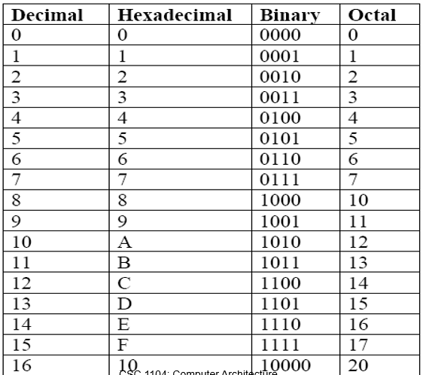
SUMMARY

Slide 11
PRACTICE QUESTIONS
Perform the following Conversions:
110011011₂ to Decimal.
27₁₀ to Binary
110011011₂ to Hexadecimal.
1C2E₁₆ to decimal.
15797₁₀ to hexadecimal
101011000110₂ to octal.
1573₈ to hexadecimal.
A748₁₆ to octal.

Slide 12
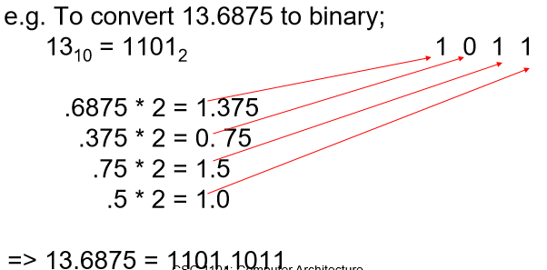
FRACTIONS
The binary equivalent of the integer portion is obtained as usual but the fraction part is obtained by successively multiplying by 2.

Slide 13
FRACTIONS
If a binary number contains digits to the right of the decimal point we convert them by starting at the binary point and move to the right.
e.g. 11.1010011011₂ = 011 101 001 101 100 = 3.5154₈ = 0011 1010 0110 1100 = 3.A6C₁₆
5.145₈=101.001 100 101 = 0101.0011 0010 1000 = 5.328₁₆
Just like in Base 10 the decimal point can be moved by multiplying by the appropriate power of the base.
e.g. 101.11 = 10111 * 2⁻² = 0.10111 * 2³

Slide 14
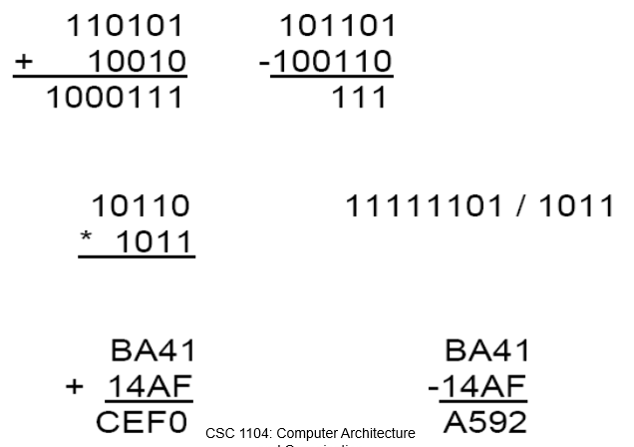
BINARY ARITHMETIC

Slide 15
REPRESENTATION OF NUMBERS IN COMPUTERS
The storage capacity of a computer’s memory and control circuitry is finite
➢ If there are n bits in a group the number of possible combinations of 0’s and 1’s is 2n. ➢ If the bits are used to represent non–negative integers, integers 0 through 2n - 1 can be represented. E.g With 8 bits integers 0 – 255 can be represented. ➢ Quite often the groups are large and n may be 24,32, 64 etc.

Slide 16
REPRESENTATION OF NUMBERS IN COMPUTERS
Big numbers are estimated using powers of ten 2¹⁰ = 1024 = 10³
2³⁶ = 2⁶.2³⁰ = 2⁶(2¹⁰)³ = 2⁶(10³)³ = 64 * 10⁹
Overflows
If the result of any operation does not fit into the number of bits reserved for it an overflow is said to occur.
All the 4 arithmetic operations can cause an overflow. 360 + 720 – 300 = 360 + (720 – 300) and (360 + 720) – 300

Slide 17
SIGNED INTEGERS

